Slide 1
RxFx
David J. Paulsen
Notes:
Hi. My name is David and I’m going to tell you about RxFx.

Slide 2
We all have different needs.

Slide 3
Finding the right Rx is costly in terms
of both time and comfort.

Slide 4
RxFx
Notes:
RxFx aims to provide people with recommendations that are personally tailored to the side effects they are most wanting to avoid.

Slide 5
Data Source
openFDA database:
3 million records self- or physician-reported entries from around the world
more than 320k drug listings
16k side effect listings
6.1 million side effects by indication
13k indications (e.g. depression)

Slide 6
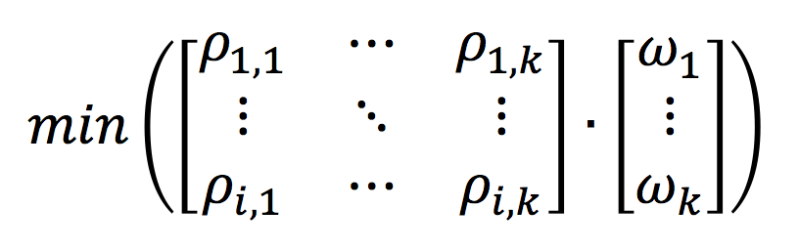
Data Cleaning
reduced ~320k drug listings to ~90k
grep & python pattern replacement, n-gram similarity
reduced openFDA data set to tables listing the proportion of patients experiencing
side effect f with drug x for indication y.
where ϖ = inverse of rank ordering preferences 1-k and
ρ_{i,k} = probabilities of side effects 1-k for drug i
Recommendation =

Slide 7


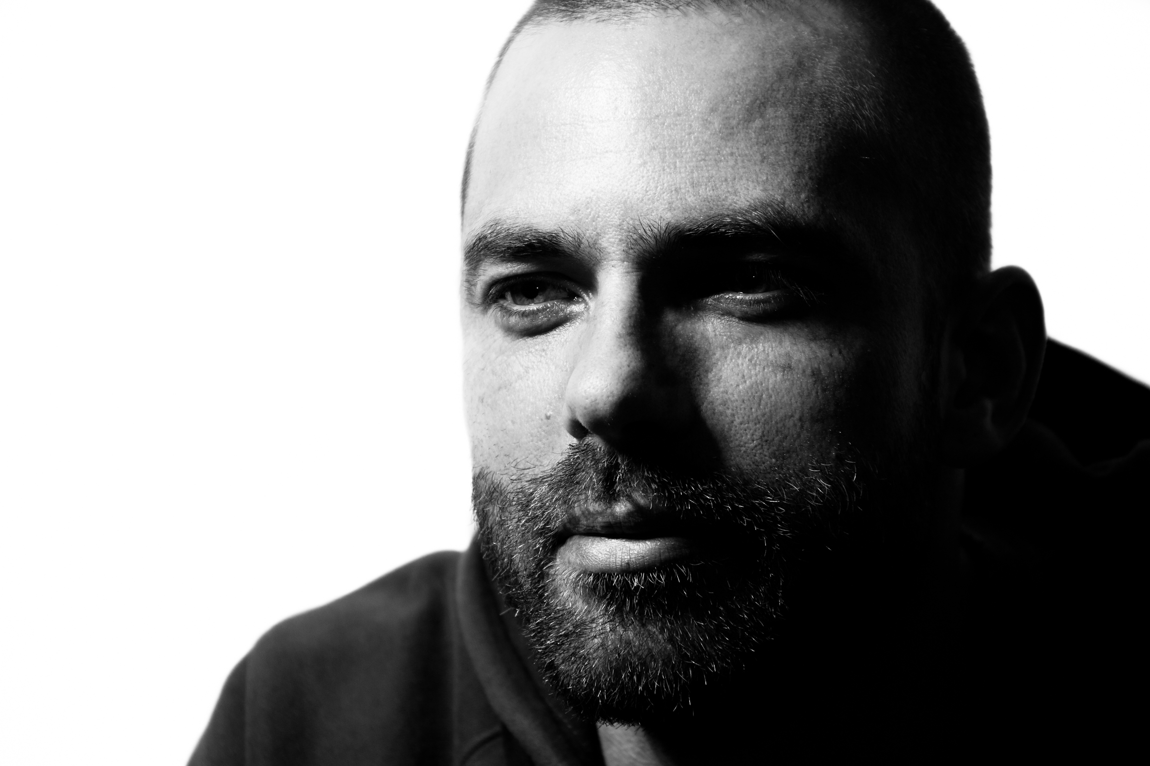

David J. Paulsen
Duke University
Center for Cognitive
Neuroscience
University of Pittsburgh
Medical Center
Development of
Risky Decision Making

